Slide 1
The Document Object Model

Slide 2

Credits
Some of the contents of this slide presentation have been referenced and reproduced from the textbook for this course, JavaScript (Sixth Edition) , Sasha Vodnik and Don Gosseling, ©2015, 2011, Cengage Learning, All Rights Reserved. ISBN 978-1-305-07844-4.

Slide 3
LEARNING OBJECTIVES
Access elements by id, tag name, class name, or CSS selector
Access element content, CSS properties, and attributes
Add and remove document nodes
Create and close new browser tabs and windows with an app
Use the setTimeout() and setInterval() methods to specify a delay or a duration
Use the History, Location, Navigation, and Screen objects to manipulate the browser window

Slide 4
Introduction to the DOM
Objects
JavaScript treats web page content as set of related components: objects
Every element on web page is an object
Document Object Model - DOM
Hierarchy of objects with set of properties and methods
Each provides programmatic access
To a different aspect of the web browser window
It is an application programming interface (API)

Slide 5
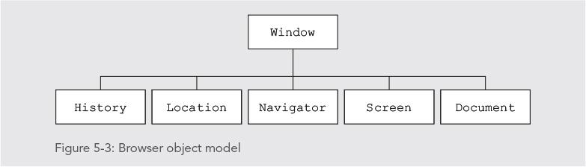
Introduction to the DOM
Window Object
Represents a Web browser window
Called the global object
Because all other DOM objects contained within it

Slide 6
Introduction to the DOM
Document Object
Represents the Web page displayed in a browser
Contains all Web page elements
JavaScript represents each element as its own object
Dynamic HTML (DHTML)
User interaction can change content of a web page without reloading
Can also change presentation of content
DHTML is combination of HTML, CSS, & JavaScript

Slide 7
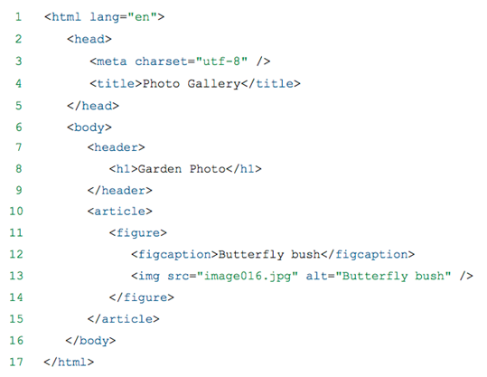
The DOM Tree
Hierarchy of the Web Page
Hierarchy depends on a document's contents and order

Slide 8
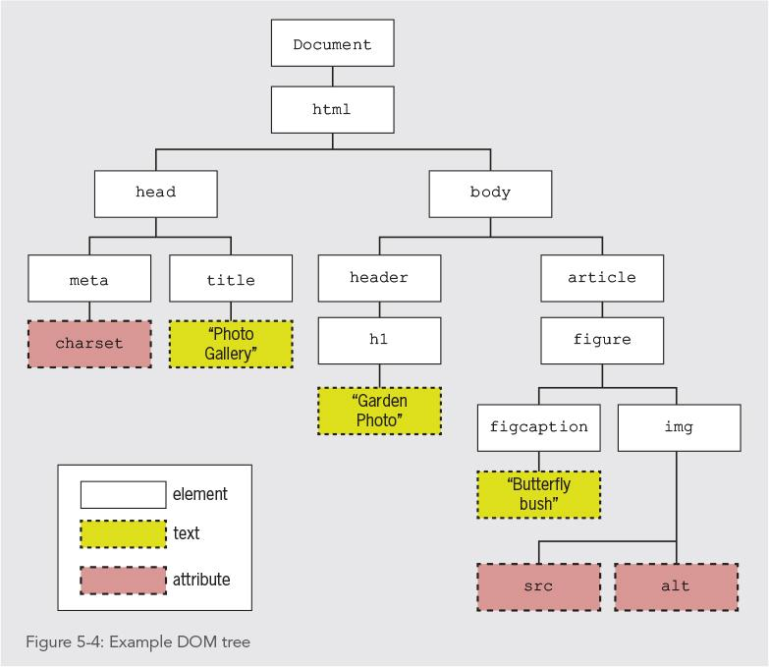
The DOM Tree
Example DOM Tree
Each item in the DOM tree is a node
Element, attribute, and text content nodes are the most commonly used

Slide 9
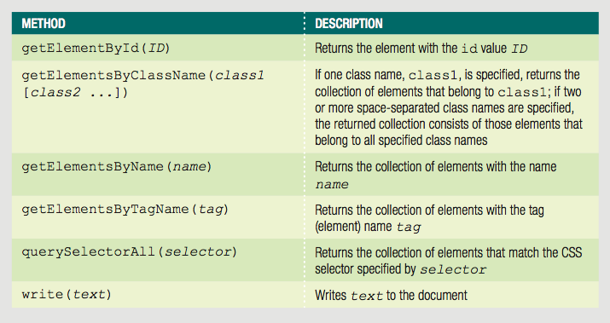
The DOM Tree
DOM Document Object Methods

Slide 10
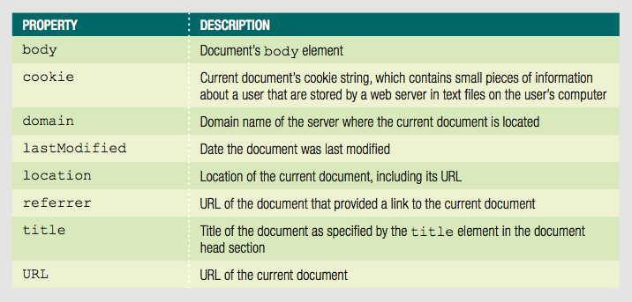
The DOM Tree
DOM Document Object Properties

Slide 11
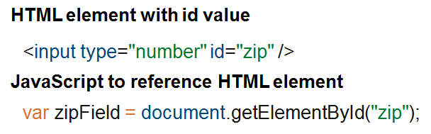
Accessing Document Elements, Content, Properties, & Attributes
Accessing Elements by id value
Set the id value in HTML
Use the getElementById()method
Returns the first element in a document with a matching id attribute

Slide 12

Accessing Document Elements, Content, Properties, & Attributes
Programming Exercise 01_05_01 – Step 1
Accessing Elements by id Value

Slide 13
Accessing Document Elements, Content, Properties, & Attributes
Accessing Elements by Tag Name
Use the getElementsByTagName()method
Tag name is the name of an element
Returns array or node list (more later) of elements matching a specified tag name
Returned in order of appearance in document

Slide 14
Accessing Document Elements, Content, Properties, & Attributes
Programming Exercise 01_05_01 – Step 2
Accessing Elements by Tag Name

Slide 15
Accessing Document Elements, Content, Properties, & Attributes
Accessing Elements by Class Name
Use the getElementsByClassName()method
Returns array or node list (more later) of elements matching a specified class attribute
class attribute takes multiple values, so method takes compound arguments
Arguments enclosed in single set of quotes, with class names separated by spaces

Slide 16
Accessing Document Elements, Content, Properties, & Attributes
Accessing Elements by Name
Use the getElementsByName()method
Returns array or node list (more later) of elements matching a specified name attribute
Not as useful as preceding options
Good for concise code when accessing set of option buttons or check boxes in a form

Slide 17
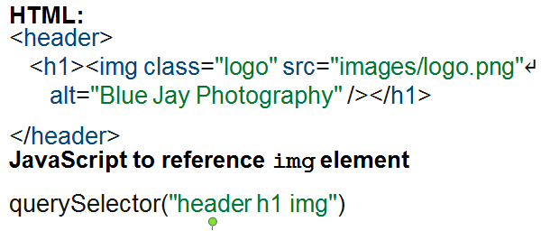
Accessing Document Elements, Content, Properties, & Attributes
Accessing Elements by CSS Selectors
Use the querySelector()method
Returns first occurrence of element matching a CSS selector

Slide 18
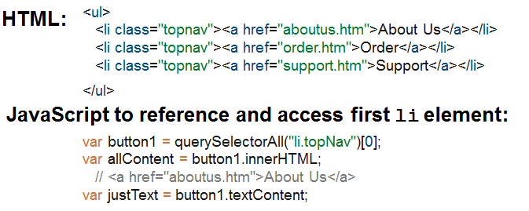
Accessing Document Elements, Content, Properties, & Attributes
Accessing Elements by CSS Selectors
Use the querySelectorAll()method
Returns collection of elements matching a CSS selector

Slide 19
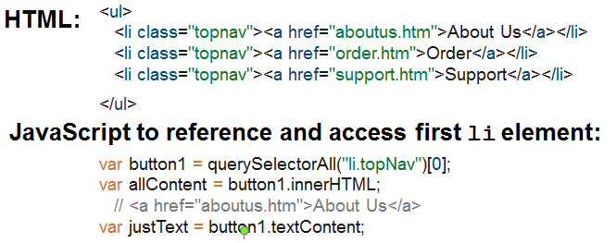
Accessing Document Elements, Content, Properties, & Attributes
Accessing an Element’s Content
Use the textContent property
Accesses and/or changes an element’s text
Unlike innerHTML, textContent strips out HTML tags

Slide 20
Accessing Document Elements, Content, Properties, & Attributes
Accessing an Element’s CSS Properties
Can access CSS properties through DOM using dot notation
Reference element's style property followed by name of CSS property
Example: change value of CSS display property to none for an element

Slide 21
Accessing Document Elements, Content, Properties, & Attributes
JavaScript Rules for CSS Properties
When CSS property includes hyphen (-), remove hyphen
CamelCase CSS property name
Example: font-family becomes fontFamily

Slide 22
Accessing Document Elements, Content, Properties, & Attributes
Accessing Element Attributes
Use dot notation with name of attribute after element reference
Use to look up attribute value & assign to variable
Use to assign new value to attribute
JavaScript exception: class attribute must be changed to className
It is a JavaScript keyword

Slide 23
Accessing Document Elements, Content, Properties, & Attributes
JavaScript Rules for CSS Properties
When CSS property includes hyphen (-), remove hyphen
CamelCase CSS property name
Example: font-family becomes fontFamily
class property must be changed to className, as it is a JavaScript keyword

Slide 24
Accessing Document Elements, Content, Properties, & Attributes
Programming Exercise 01_05_01 – Step 3
Accessing Element Attributes

Slide 25
Adding and Removing DOM Nodes
Changing the DOM Node Tree
DOM includes methods to change the tree
Can create brand new elements
Can add or remove elements from DOM tree

Slide 26

Adding and Removing DOM Nodes
Creating Nodes
Use the createElement() method
Example: to create a new <div> element:

Slide 27
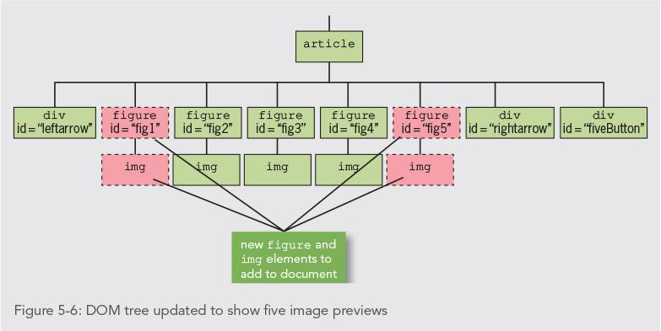
Adding and Removing DOM Nodes
Creating Nodes

Slide 28
Adding and Removing DOM Nodes
Programming Exercise 01_05_01 – Step 4
Creating Nodes

Slide 29
Adding and Removing DOM Nodes
Attaching Nodes
A newly created node is independent of the DOM tree
Use the appendChild() method to attach it to the tree
Syntax parentNode.appendChild(childNode);
childNode is node to be attached
parentNode is node to attach child node to

Slide 30

Adding and Removing DOM Nodes
Example
Create new li element and attach to element with id value navList
Document Fragment
Set of connected nodes not part of document
Can use appendChild() to add document fragment to DOM tree for a document

Slide 31
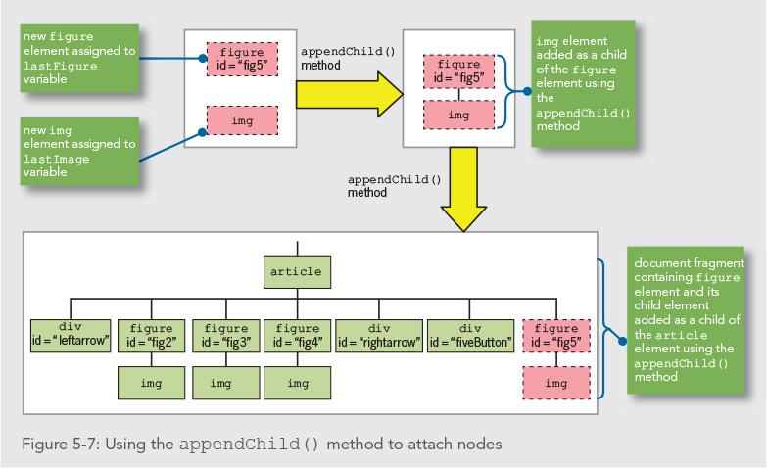
Adding and Removing DOM Nodes
Attaching Nodes

Slide 32
Adding and Removing DOM Nodes
Programming Exercise 01_05_01 – Step 5
Attaching Nodes

Slide 33
Adding and Removing DOM Nodes
Cloning Nodes
Create a new node the same as an existing node
Use the cloneNode() method
Syntax existingNode.cloneNode(true | false);
true includes child nodes of the existing node
false clones only specified node

Slide 34

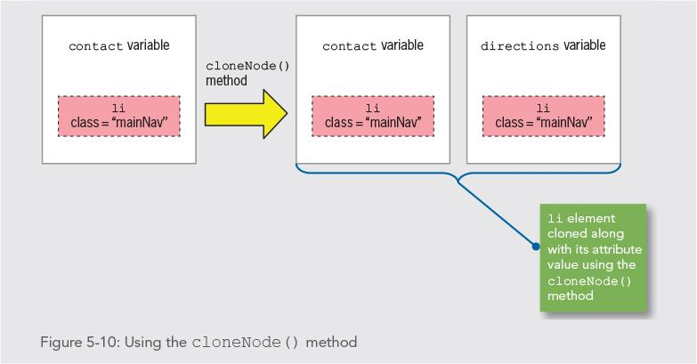
Adding and Removing DOM Nodes
Example

Slide 35
Adding and Removing DOM Nodes
Programming Exercise 01_05_01 – Step 6
Cloning Nodes

Slide 36
Adding and Removing DOM Nodes
Inserting Nodes at Specific Positions
appendChild() adds nodes after all existing child nodes
Use insertBefore() to specify a different position in the tree
Syntax parentNode.insertBefore( newchildNode, existingChildNode);

Slide 37
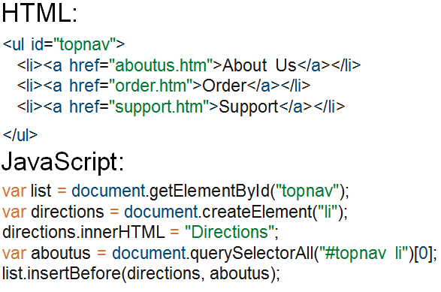
Adding and Removing DOM Nodes
Example

Slide 38
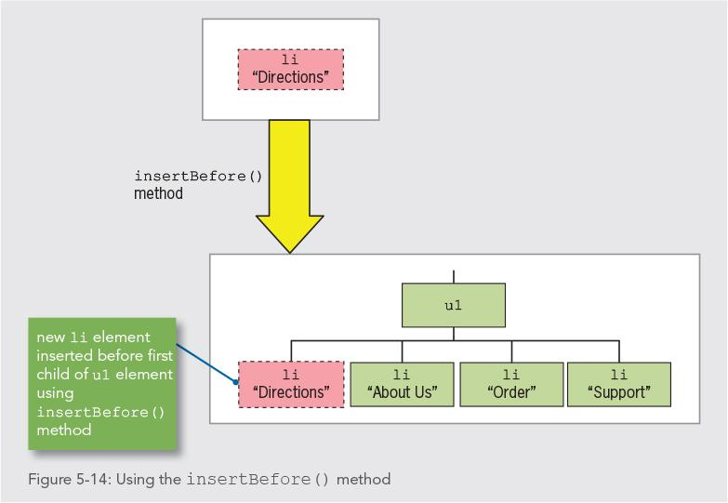
Adding and Removing DOM Nodes
Example

Slide 39
Adding and Removing DOM Nodes
Programming Exercise 01_05_01 – Step 7
Inserting Nodes at Specific Positions

Slide 40

Adding and Removing DOM Nodes
Removing Nodes
removeChild() removes a node from the DOM tree
Syntax parentNode.removeChild(childNode);
Node removed without being assigned to a variable is deleted during garbage collection
Can assign removed node to variable to save it

Slide 41
Adding and Removing DOM Nodes
Programming Exercise 01_05_01 – Step 8
Removing Nodes

Slide 42
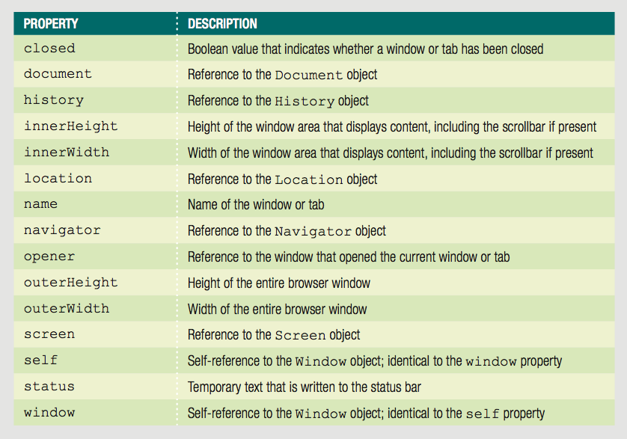
Manipulating the Browser with the Window Object
window Object Properties

Slide 43
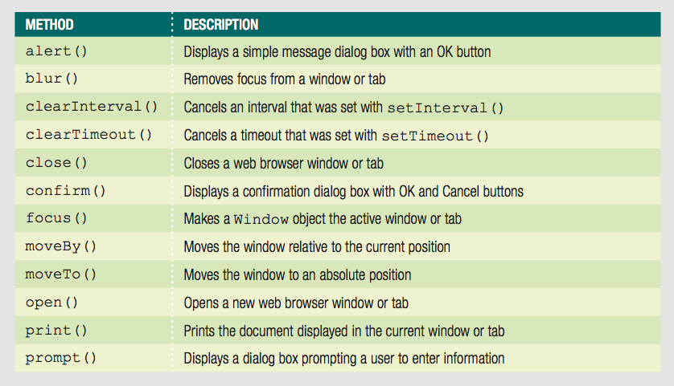
Manipulating the Browser with the Window Object
window Object Methods

Slide 44
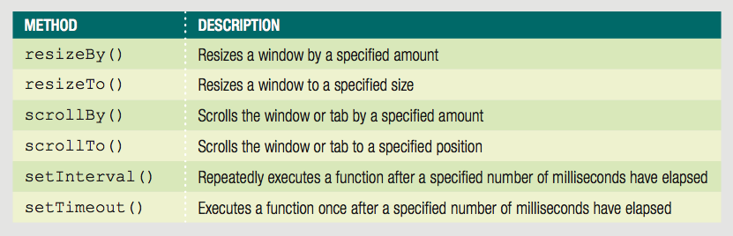
Manipulating the Browser with the Window Object
window Object Methods

Slide 45
Manipulating the Browser with the Window Object
self Property
Refers to the current window object
Identical to using the window property Examples:
window.close();
self.close();
Web browser assumes a reference to global object
Best Practice: use window or self references when referring to a window object property or method

Slide 46

Manipulating the Browser with the Window Object
Opening and Closing Windows and Tabs
Reasons to open a new browser window
To launch a new Web page in a separate window
To use an additional window to display information
When new browser window is opened, a new window object created
Represents the new window
Know how to open a link in a new window using the <a> element’s target attribute

Slide 47
Manipulating the Browser with the Window Object
Opening a Window or Tab
Use open() method of the window object to open a new window
window.open(url,name,options,replace);
All but url are optional
url: web address or filename to be opened
name: assigns value to name property of new window object
options: string to customize window appearance
replace: Boolean true indicates create new entry in history, false replace current window entry

Slide 48
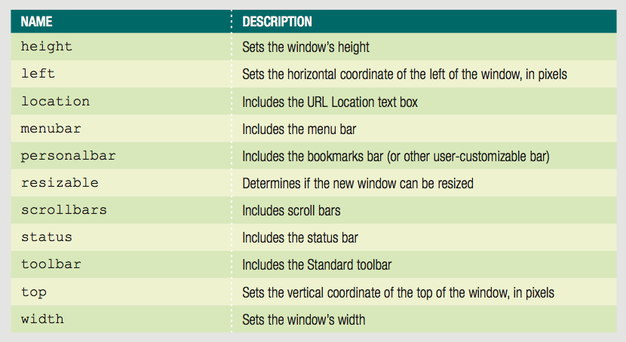
Manipulating the Browser with the Window Object
window.open() Arguments
window.open(”about.html”, ”AboutWindow”, ”menubar=no, scrollbar=no”, false);

Slide 49
Manipulating the Browser with the Window Object
Programming Exercise 01_05_01 – Step 9
Opening a New Window

Slide 50
Manipulating the Browser with the Window Object
Closing a Window or Tab
Use close() method of the window object to open a new window
window.close(); self.close();
Closes the current window

Slide 51
Manipulating the Browser with the Window Object
Programming Exercise 01_05_01 – Step 10
Closing a Window

Slide 52
Manipulating the Browser with the Window Object
Working with Timeouts and Intervals
window object timeout() and interval() methods creates code that executes automatically
setTimeout() method
Executes code after a specific amount of time
Executes only once
Syntax
var variable = setTimeout("code", milliseconds);

Slide 53
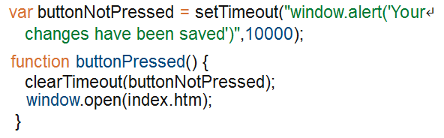
Manipulating the Browser with the Window Object
Working with Timeouts and Intervals
clearTimeout() method
Cancel setTimeout() before its code executes
Syntax

Slide 54
Manipulating the Browser with the Window Object
Working with Timeouts and Intervals
setInterval() method
Repeatedly executes the same code after being called only once
Syntax
var variable = setInterval("code", milliseconds);
clearInterval() method
Used to clear setInterval() method call

Slide 55
Manipulating the Browser with the Window Object
Programming Exercise 01_05_01 – Step 11
Working with Timeouts and Intervals

Slide 56
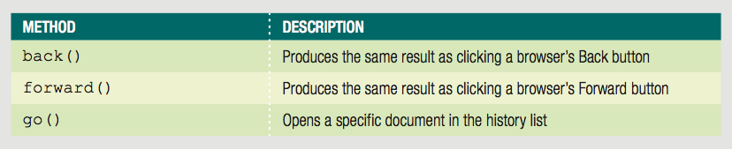
Other DOM Objects
history Object
Maintains internal list (history list)
All documents opened during current web browser session
Security features: will not display URLs contained in the history list

Slide 57
Other DOM Objects
history Object
go() method
Allows navigation to a previously visited web page
history object length property
Provides specific number of documents opened during the current browser session
Example:
Return to first document opened in current browser session history.go(-(history.length - 1));

Slide 58
Other DOM Objects
location Object
Allows changes to a new web page from within JavaScript code
location object properties allow modification of URL individual portions
Web browser automatically attempts to open that new URL

Slide 59
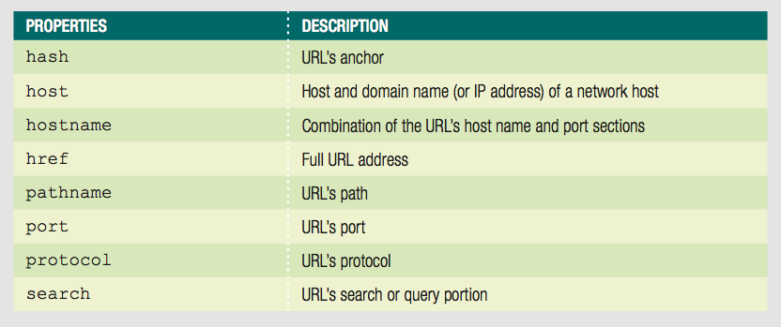
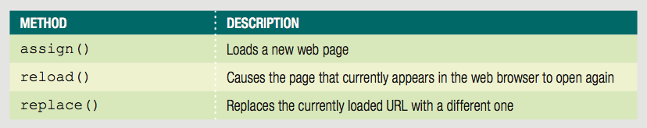
Other DOM Objects
location Object

Slide 60
Other DOM Objects
location Object
Location object’s assign() method
Same action as changing the href property
Loads a new web page
Location object’s reload() method
Equivalent to the browser Reload or Refresh button
Causes current page to open again
Location object’s replace() method
Replaces currently loaded URL with a different one

Slide 61
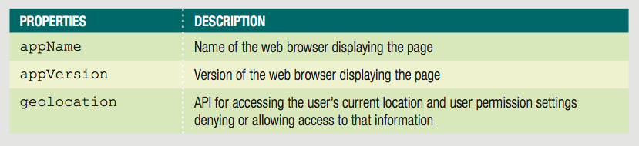
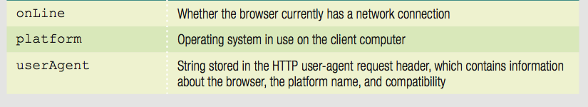
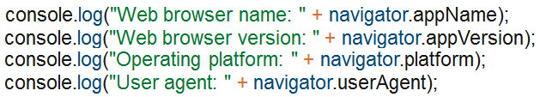
Other DOM Objects
navigator Object
Obtains information about current web browser
Example: determine type of web browser running

Slide 62
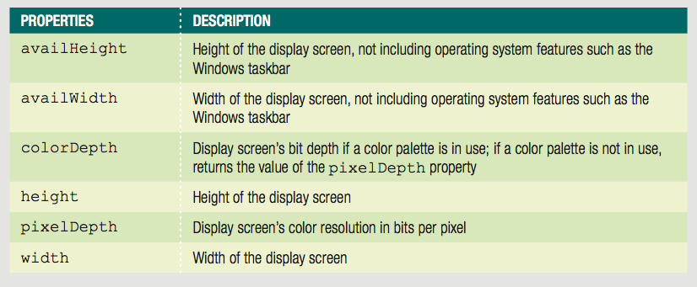
Other DOM Objects
screen Object
Obtains information about display screen’s size, resolution, color depth
Common use of screen object properties
Centering a web browser window in the middle of the display area

Slide 63
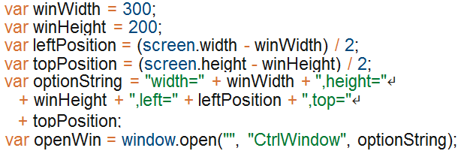
Other DOM Objects
screen Object
Centering a web browser window in the middle of the display area

Slide 64
Other DOM Objects
Programming Exercise 01_05_01 – Step 12
screen Object

